Slide 1
Driver Liability Prediction Using Crash Data
Arjun Pagidi and Abhi Palikala

Slide 2
Statement and Project Goal
Determining fault is vital for insurance payouts and other legal or monetary activities. However, determining fault is a difficult process when the parties don’t agree.
A good model could help improve road safety by highlighting key risk factors, guiding preventative measures, and informing traffic policies.
Additionally, the insights from this project could be valuable for law enforcement agencies, insurance companies, and urban planners to better understand the dynamics of traffic incidents and ultimately reduce the number of preventable accidents on the road.
Therefore, the goal of this project is to develop a machine learning model that predicts whether a driver was at fault in a traffic incident using the Montgomery County Crash Reporting Incidents dataset.
Notes:
Arjun

Slide 3
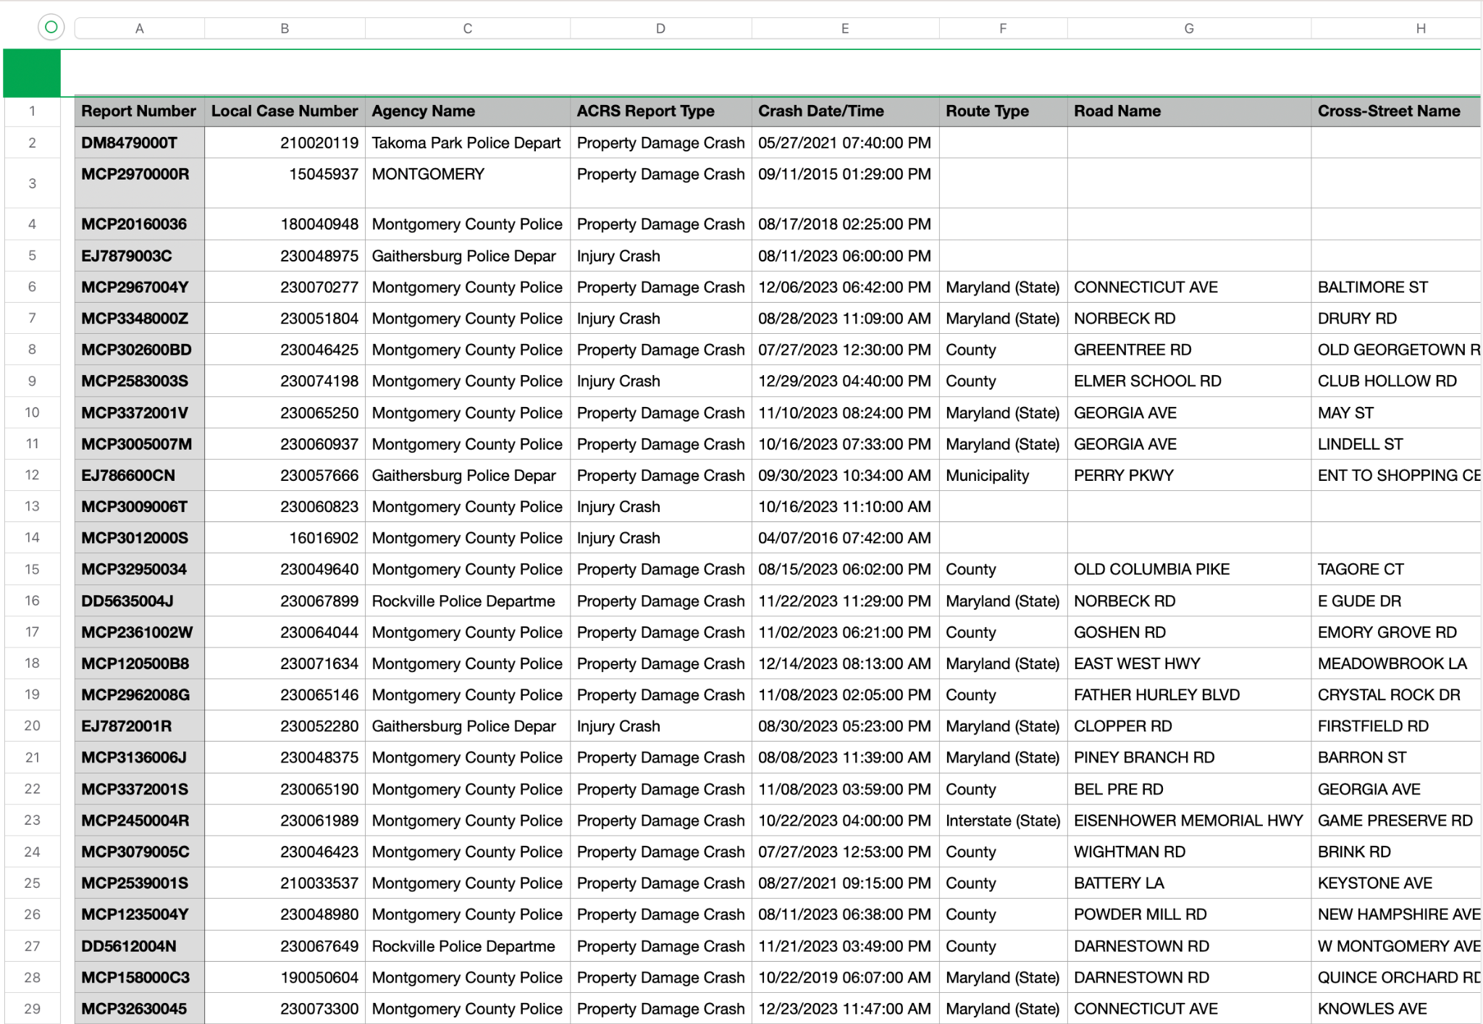
Dataset
The data set consists of about 180,000 instances with 38 attributes (not including the class label). This dataset provides information on motor vehicle operators (drivers) involved in traffic collisions occurring on county and local roadways.
Notes:
Abhi

Slide 4
Dataset Continued…
Some of the attributes in the data set are…
Collision Type: Type of collision (e.g., rear-end, side-impact).
Weather: Weather conditions at the time of the incident.
Surface Condition: Road surface condition (e.g., wet, dry, icy).
Light: Lighting conditions (e.g., daylight, dark, dawn).
Traffic Control: Presence and type of traffic control devices (e.g., stop signs, signals).
Driver Substance Abuse: Information on driver impairment due to substances.
Non-Motorist Substance Abuse: Information on non-motorist impairment due to substances.
Person ID: Unique ID for the person involved in the incident.
There are many more
Notes:
Abhi

Slide 5
Preprocessing + Split
1. Formatting for Weka
Remove new lines
Remove quotation marks
Reformat Date to only keep the minutes
2. Remove redundant attributes
3. Remove instances with class null values
4. Replace null values in other attributes
5. Discretize/Binning
After preprocessing, we ended up with 24 attributes.
We did a stratified random train/test split with the use of Weka’s “stratifiedRemoveFolds”, yielding an 80-20 split stratified with respect to the class label “At Fault”. The resulting train and test splits had the same percentage of each class (to the nearest whole instance).
Notes:
Abhi

Slide 6
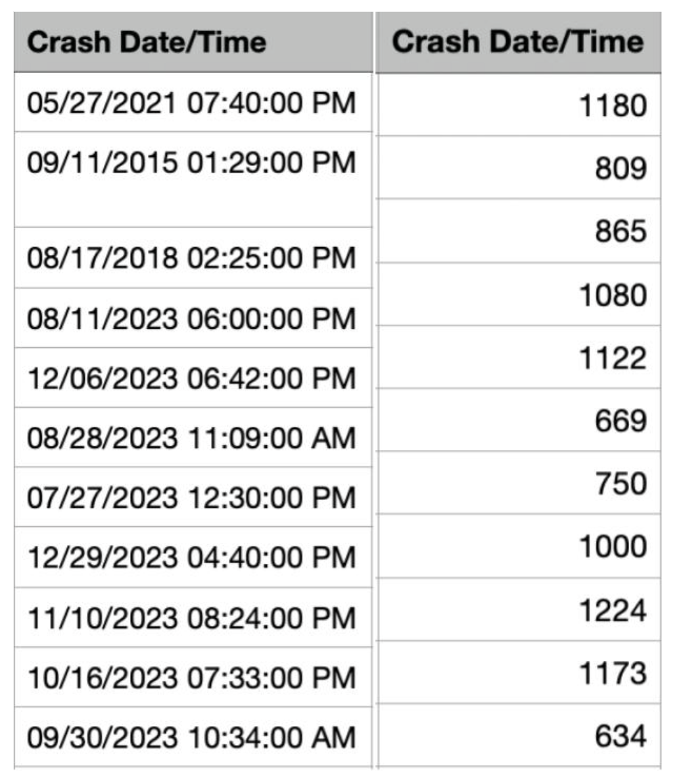
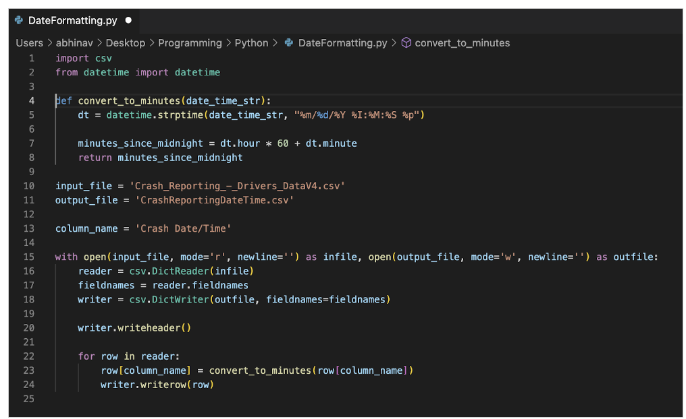
Date/Time Attribute
Notes:
Abhi

Slide 7
Attribute Selection
Notes:
Abhi

Slide 8
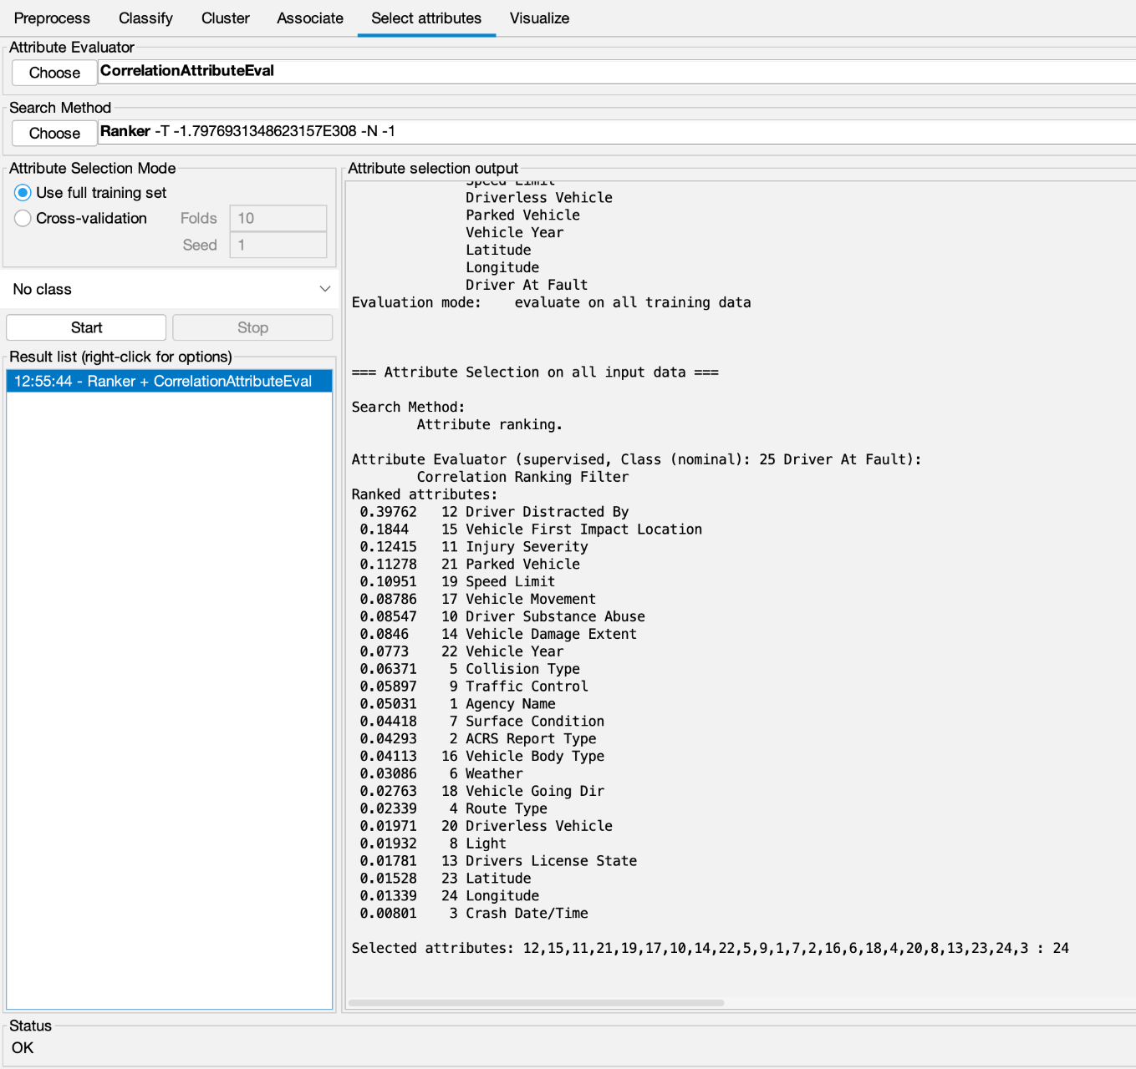
Correlation Based Feature Selection
Using the CorrelationAttributeEval attribute selection algorithm and the Ranker search method, we obtained the following analysis.
When selecting our attributes, we set a cutoff of 0.075. Thus, the following attributes were selected to be included based on this algorithm: ‘Driver Distracted By’, ‘Vehicle First Impact Location’, ‘Injury Severity’, ‘Parked Vehicle’, ‘Speed Limit’, ‘Vehicle Movement’, ‘Driver Substance Abuse’, ‘Vehicle Damage Extent’, and ‘Vehicle Year’.
Notes:
Abhi

Slide 9
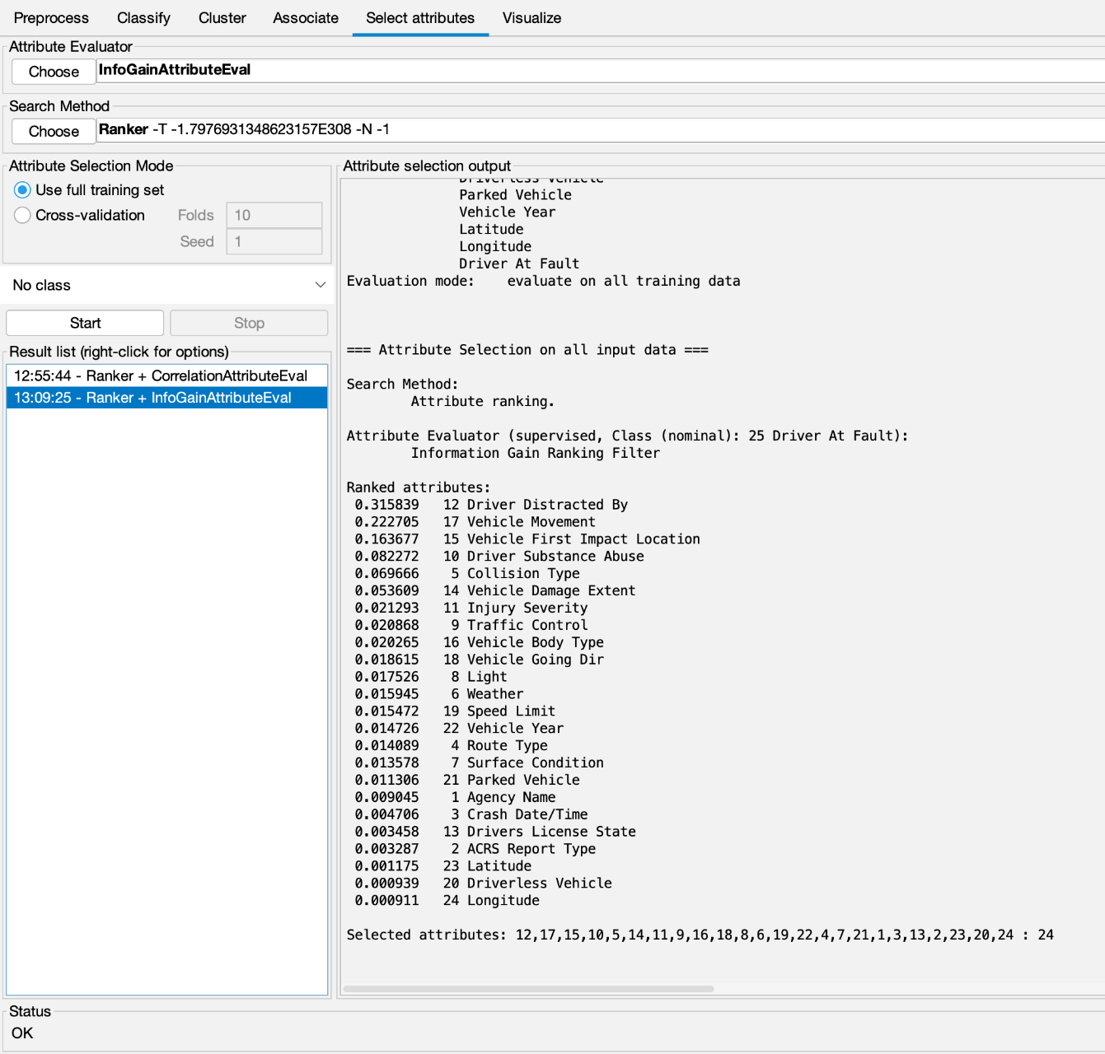
Info Gain Based Attribute Selection
Our second dataset was created using the InfoGainAttributeEval algorithm provided by WEKA, which also uses the Ranker search method.
We chose a cutoff of 0.02. As such, we kept the attributes ‘Driver Distracted By’, ‘Vehicle Movement’, ‘Vehicle First Impact Location’, ‘Driver Substance Abuse’, ‘Collision Type’, ‘Vehicle Damage Extent’, ‘Injury Severity’, ‘Traffic Control’, and ‘Vehicle Body Type’.
Notes:
Abhi

Slide 10
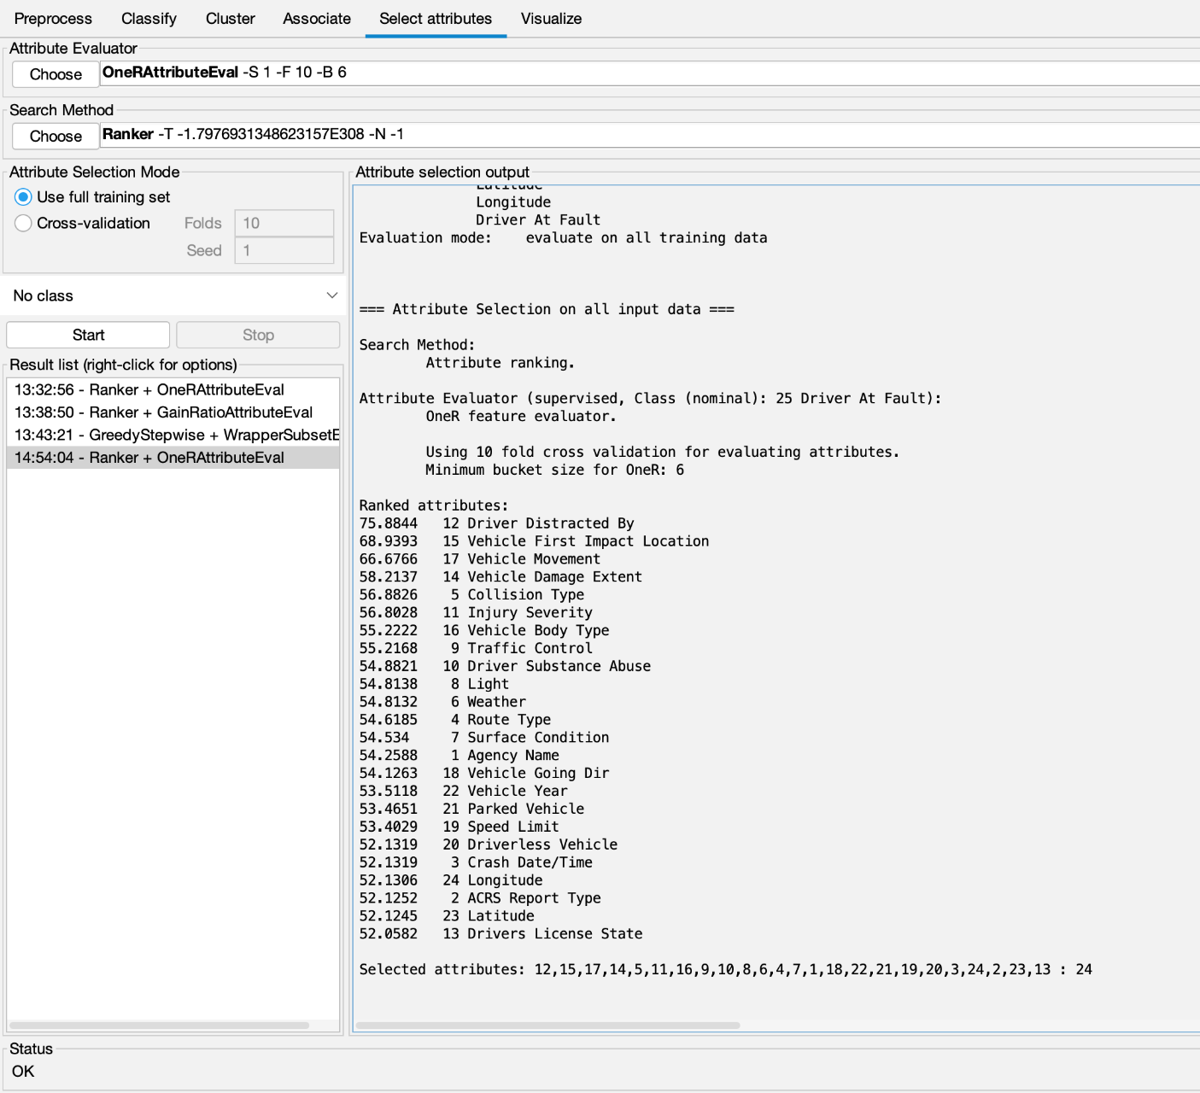
OneR Based Selection
This dataset was created using the OneRAttributeEval attribute evaluator, which uses the Ranker search method. The following results were obtained.
Based on the cutoff value of 54.5, the attributes we chose to keep were: ‘Driver Distracted By’, ‘Vehicle First Impact Location’, ‘Vehicle Movement’, ‘Vehicle Damage Extent’, ‘Collision Type’, ‘Injury Severity’, ‘Vehicle Body Type’, ‘Traffic Control’, ‘Driver Substance Abuse’, ‘Light’, ‘Weather’, ‘Route Type’, and ‘Surface Condition’.
Notes:
Abhi

Slide 11
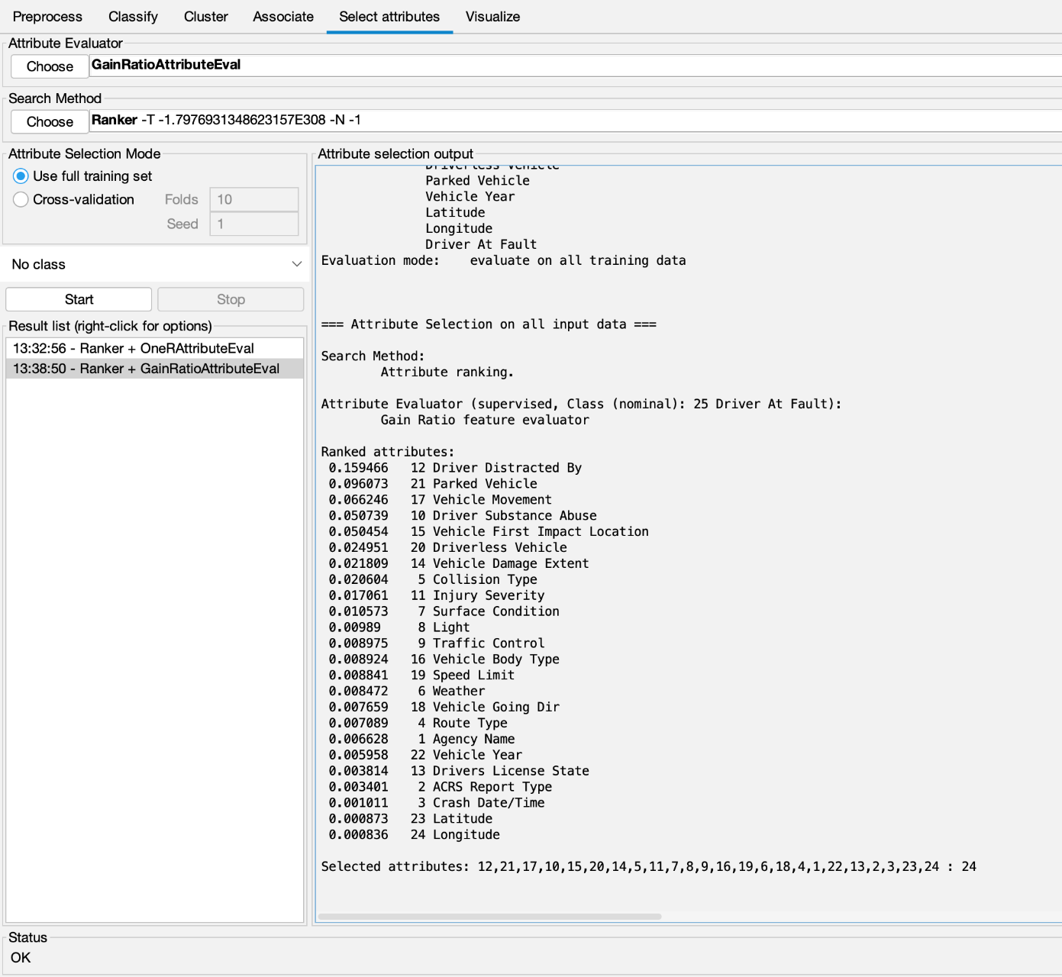
Gain Ratio Evaluation
This dataset was created using the GainRatioAttributeEval, which uses the Ranker search method. The results are shown below.
After setting a cutoff of 0.01, we decided to keep the following attributes: ‘Driver Distracted By’, ‘Parked Vehicle’, ‘Vehicle Movement’, ‘Driver Substance Abuse’, ‘Vehicle First Impact Location’, ‘Driverless Vehicle’, ‘Vehicle Damage Extent’, ‘Collision Type’, ‘Injury Severity’, and ‘Surface Condition’.
Notes:
Abhi

Slide 12
Self Selected Attributes
For the self-selected attributes, we chose to include any attribute that was suggested to be kept by any one of the attribute selection algorithms above. In other words, the only attributes removed were the ones that were considered ‘useless’ by every single attribute selection algorithm.
Notes:
Abhi

Slide 13
Model Selection
Notes:
Abhi

Slide 14
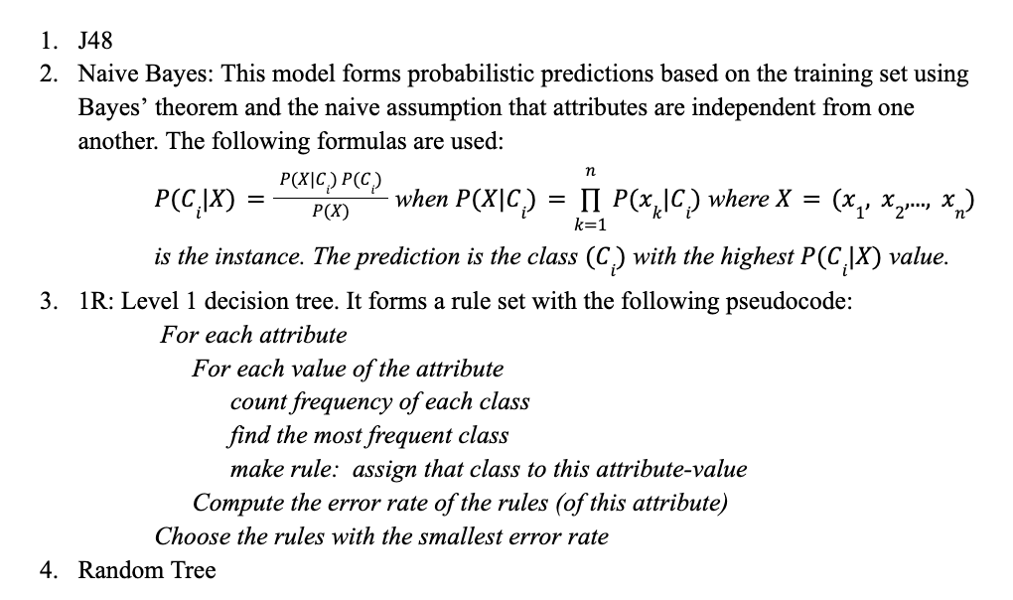
Algorithms and Models Used

Slide 15
Classification Results: Naive Bayes
Attribute Selection Type | Accuracy
Correlation | 80.52%
GainRatio | 79.58
OneR | 79.89
InfoGain | 78.40
Self-Picked | 81.16

Slide 16
Classification Results: J48
Attribute Selection Type | Accuracy
Correlation | 83.35
GainRatio | 86.46
OneR | 86.92
InfoGain | 87.85
Self-Picked | 86.87

Slide 17
Classification Results: OneR
Attribute Selection Type | Accuracy
Correlation | 76.13
GainRatio | 76.13
OneR | 76.13
InfoGain | 76.13
Self-Picked | 76.13

Slide 18
Classification Results: Random Tree
Attribute Selection Type | Accuracy
Correlation | 78.63
GainRatio | 85.01
OneR | 84.44
InfoGain | 81.84
Self-Picked | 81.325

Slide 19
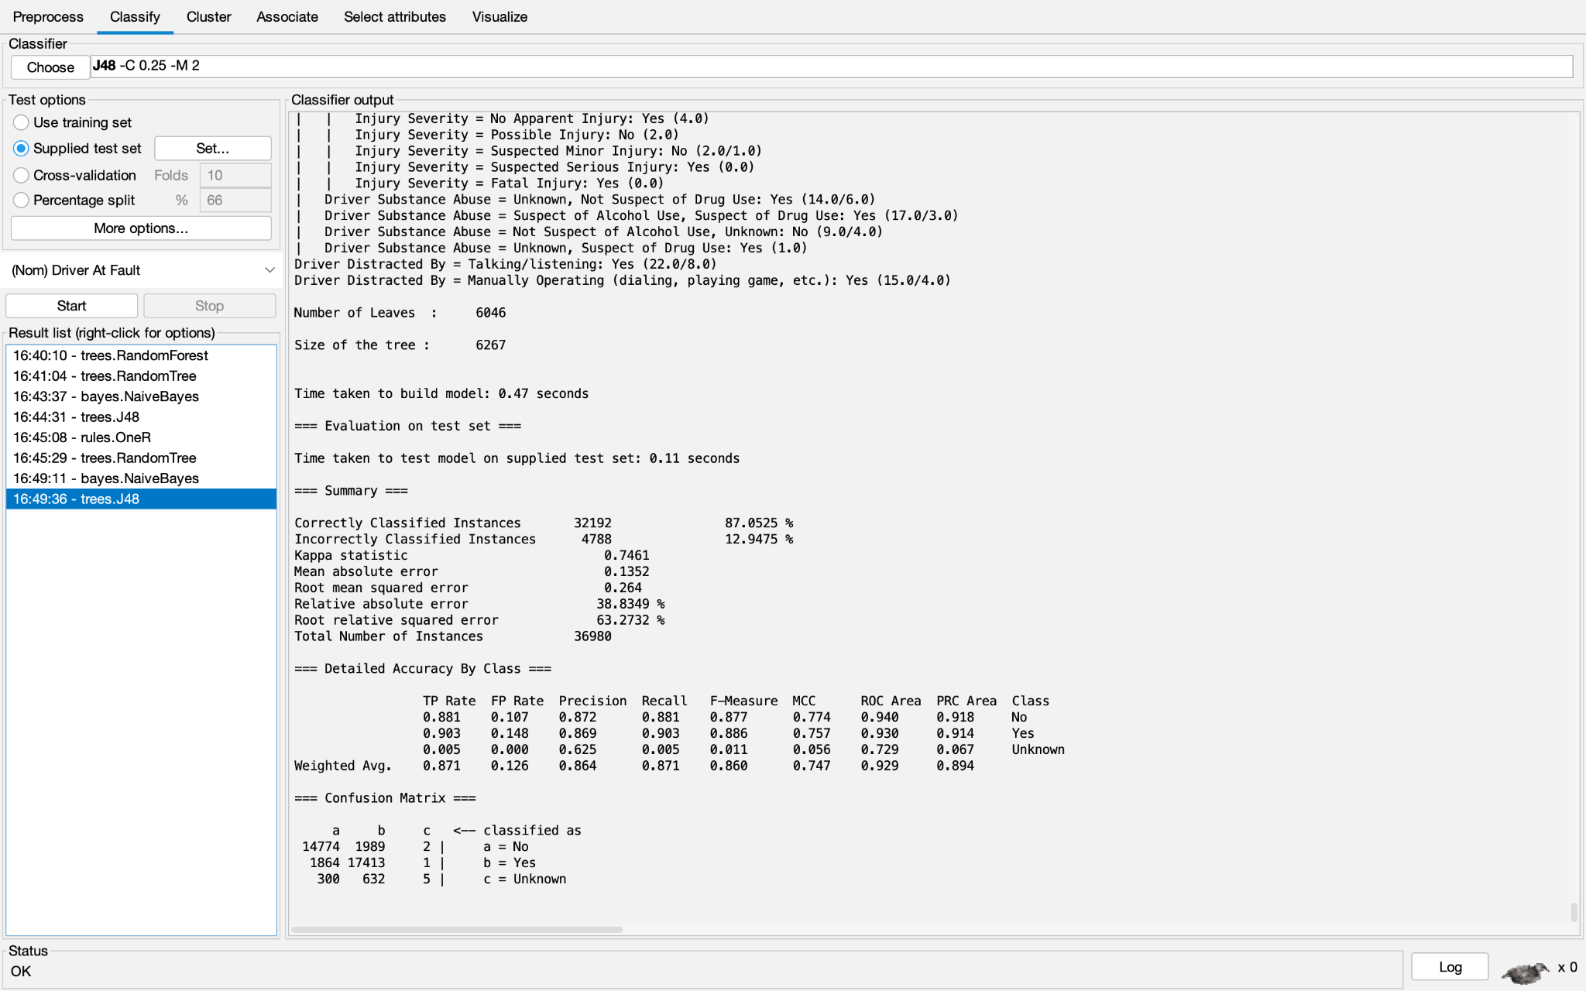
Results and Conclusions
We used accuracy as a measure of how good the model was because our data had very little skew (56% yes, and 44% no)
Our model determined that J48 with the InfoGainEval dataset had the best accuracy of 87%.
Highest TP Rate: 90.3%
Lowest Mean Squared Error: 0.264
This accuracy is decently high and provides decent prediction of who is at fault

Slide 20
How to Reproduce
Under the Preprocess tab, remove the attributes which prevent arff to csv conversion
Open Weka and load the “rawdata.csv” dataset.
Remove redundant attributes
Parse dates into only the minutes using the python code (code included on report)
Select the attributes according to the corresponding attribute selection algorithm.
Split the data into train and test splits.
Train the desired model (J48) using the test set as a “supplied test set”.
Click Start.

Slide 21
Sources
Google Drive: https://drive.google.com/drive/folders/110G13sFcdTgHHQABhNVw3vTYZuXPTyYH
Dataset:
https://catalog.data.gov/dataset/crash-reporting-drivers-data

